Slide 1
Tenex Health
Anatomy and Application

Slide 2
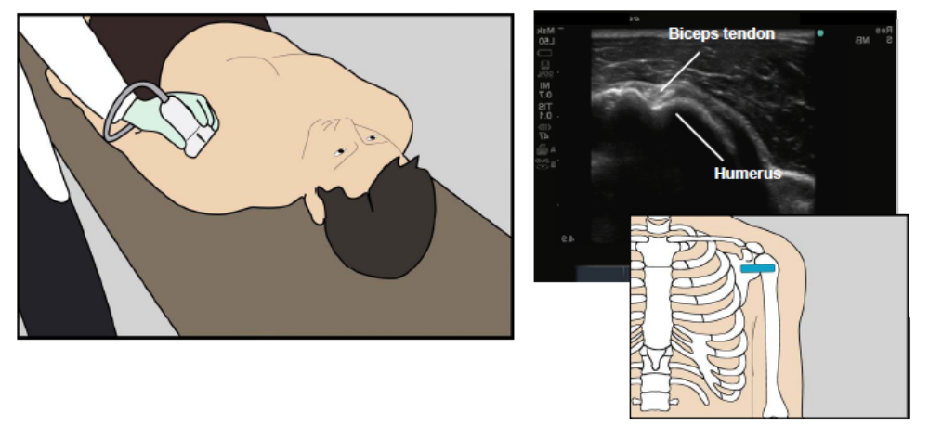
Patient and probe positioning Biceps

Slide 3
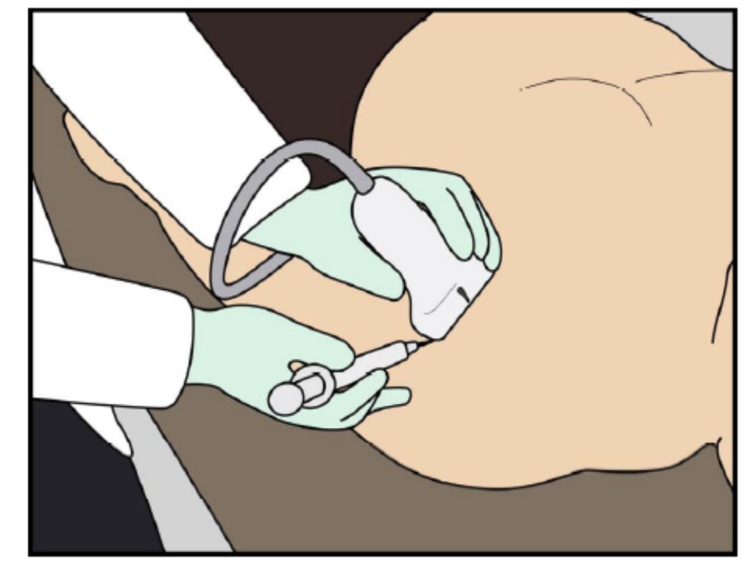
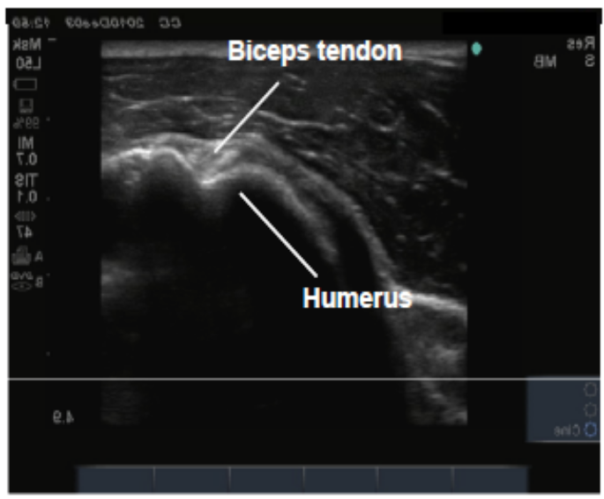
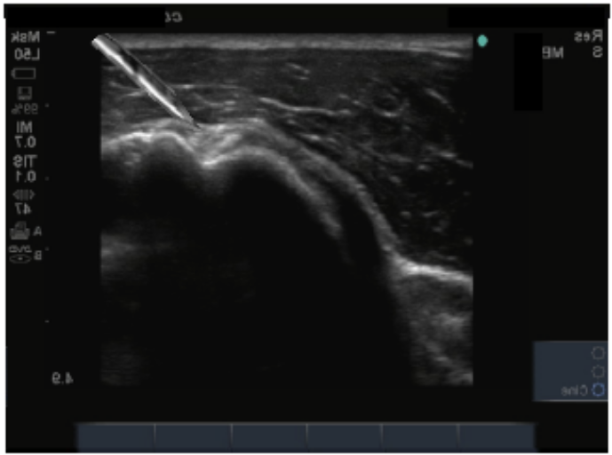
Biceps with TX2
TX 2
Biceps tendon

Slide 4
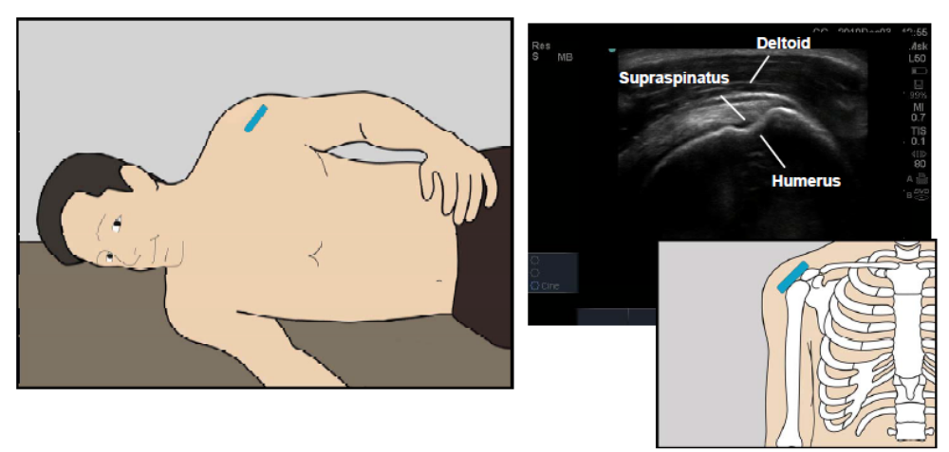
Patient and probe positioning Shoulder

Slide 5
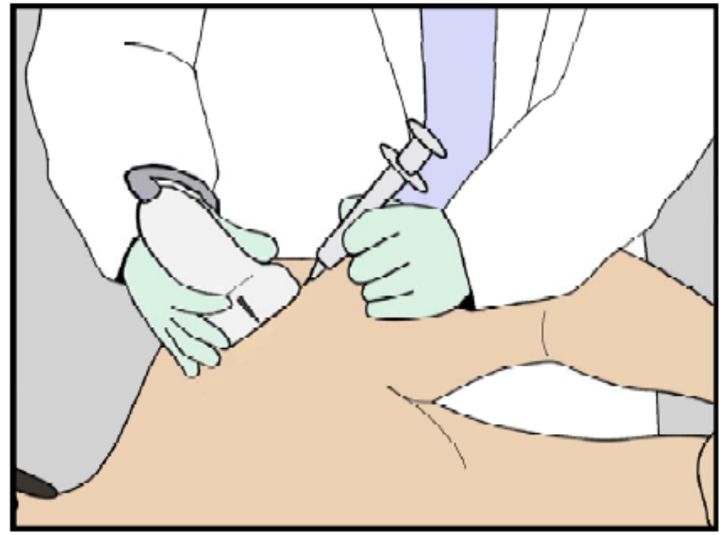
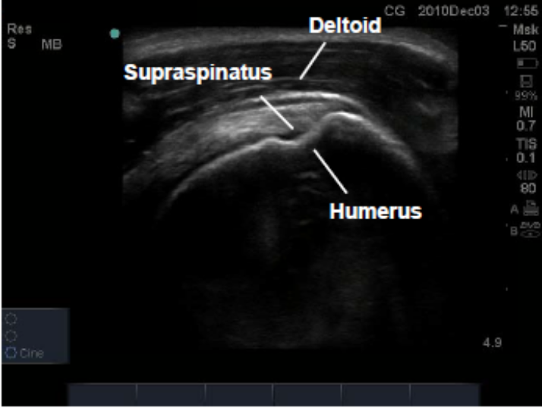
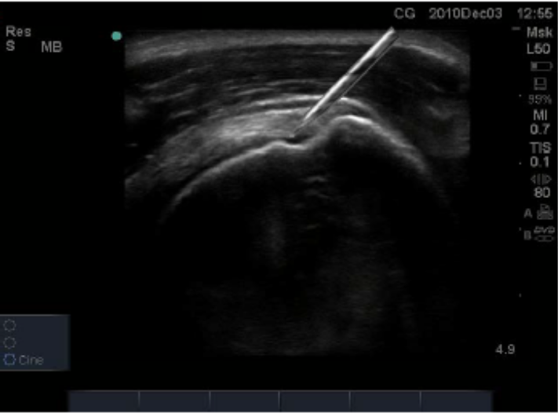
Shoulder with TX 2

Slide 6
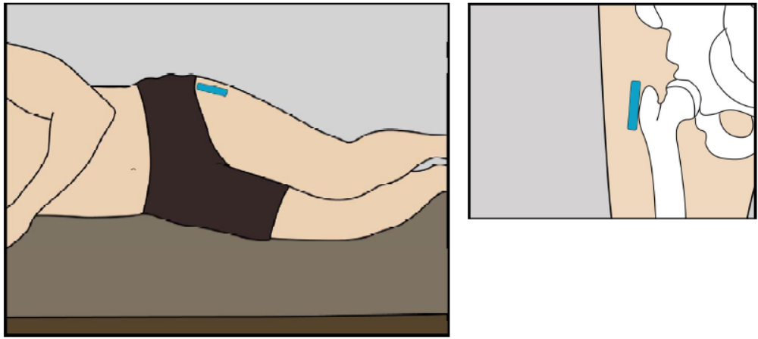
Patient and probe positioning Hip

Slide 7
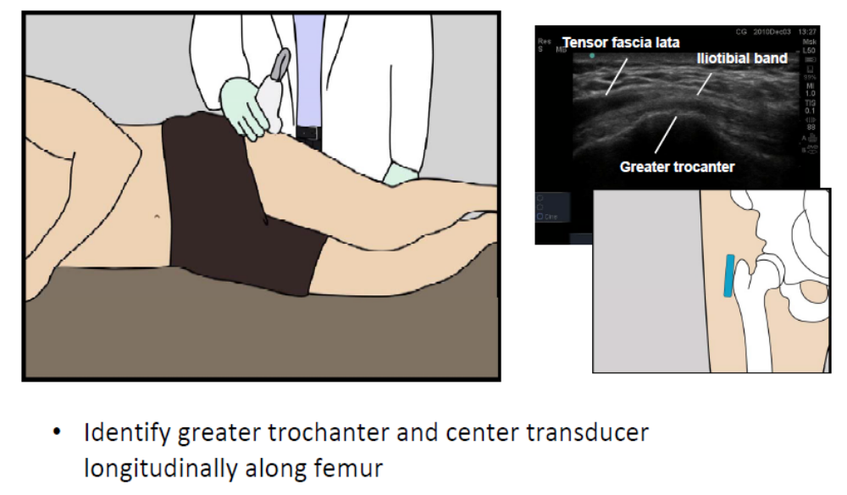
Greater trochanteric bursa

Slide 8
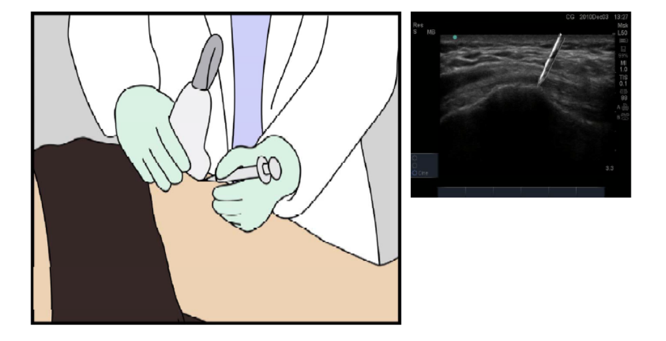
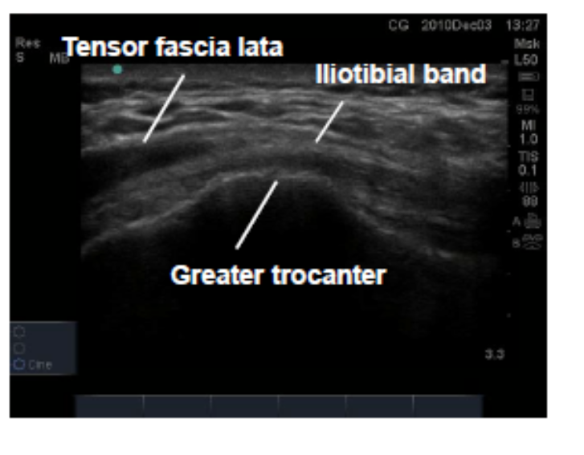
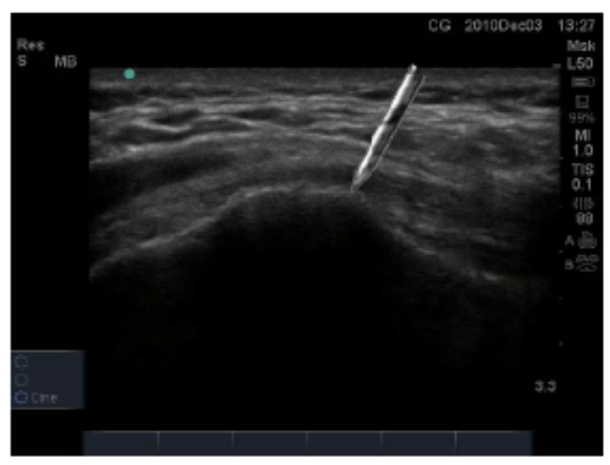
Greater trochanteric bursa TX2

Slide 9
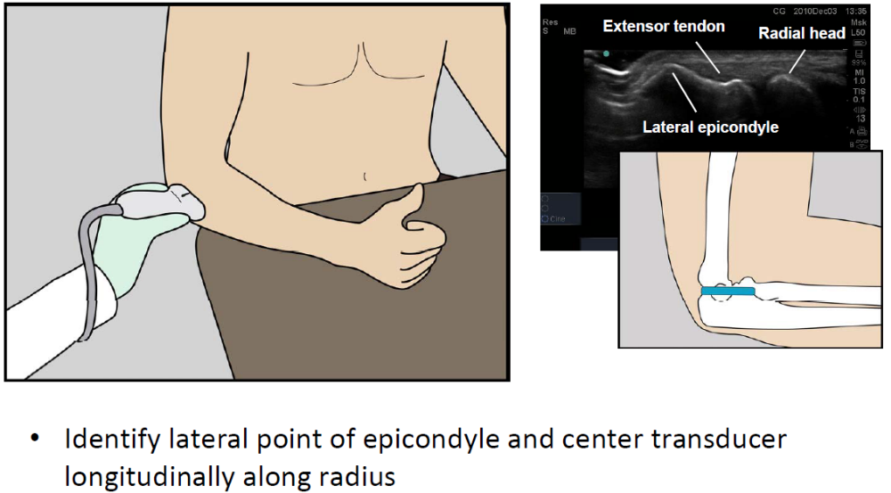
Tenex lateral elbow

Slide 10
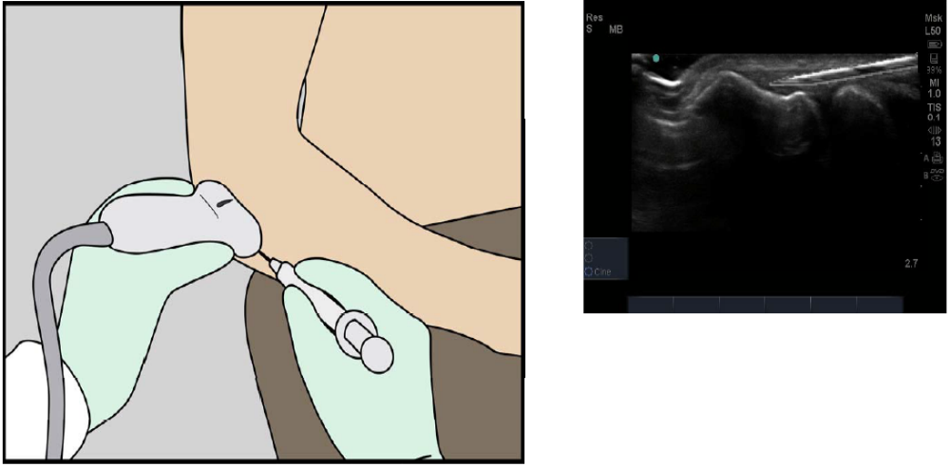
Needle placement

Slide 11
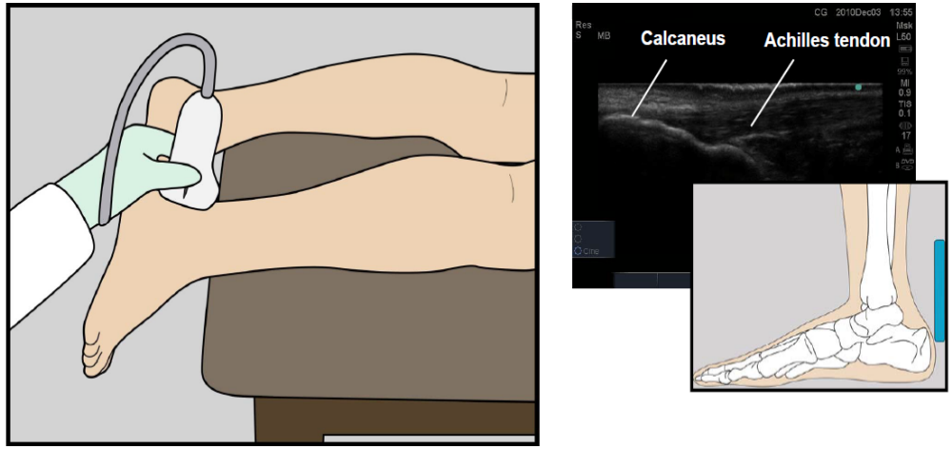
Patient and probe positioning Achilles

Slide 12
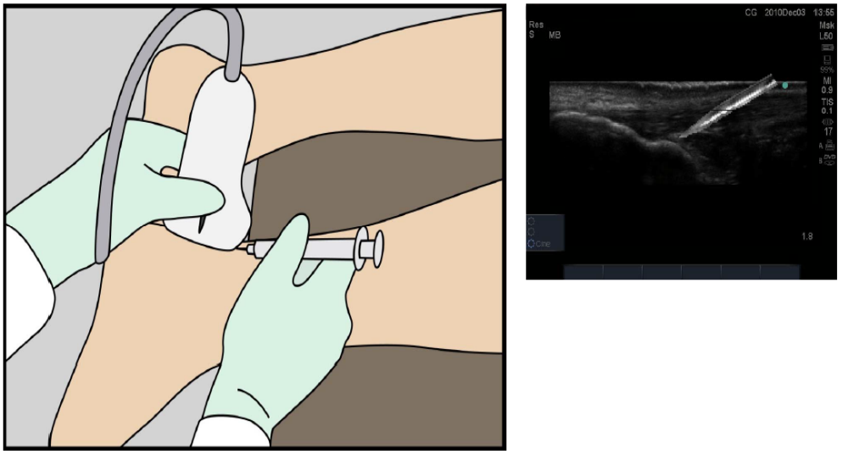
Tenex in Achilles

Slide 13
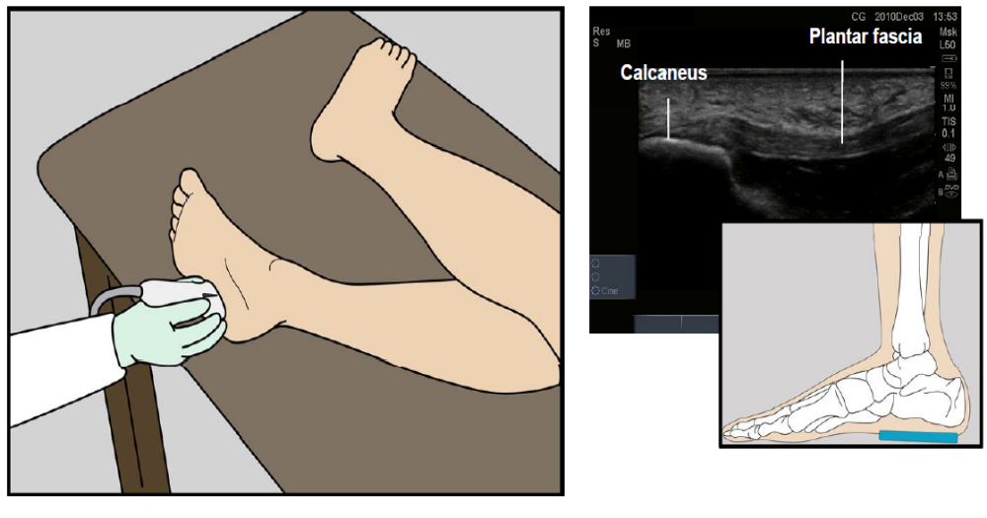
Patient and probe positioning Plantar
Fascia

Slide 14
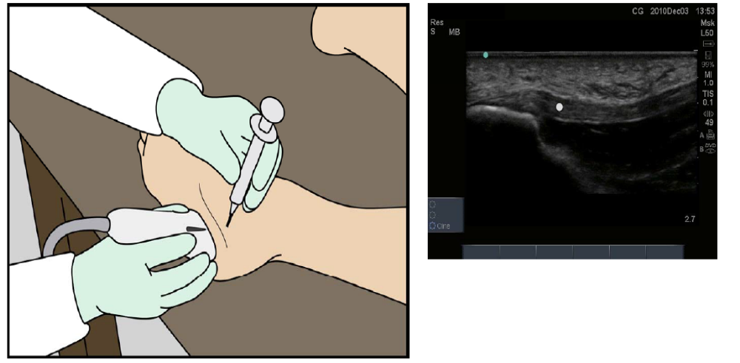
Tenex in Plantar Fascia short axis

Slide 15
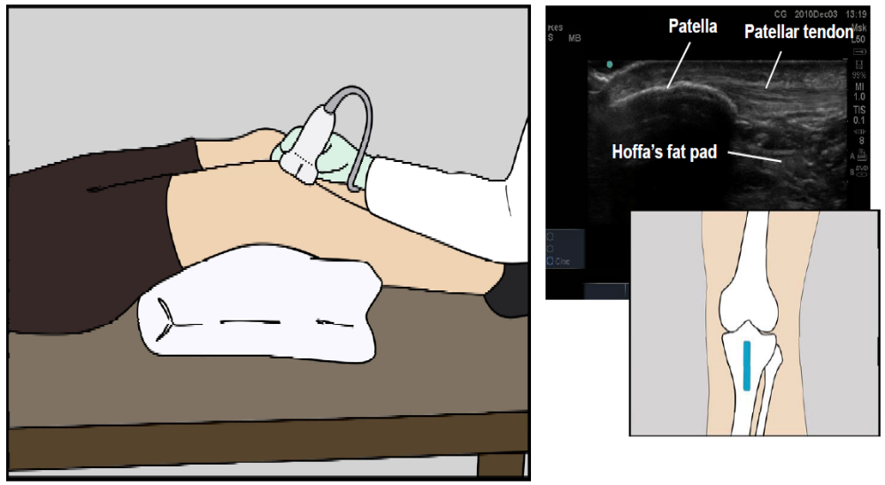
Patient and probe positioning Patellar tendon

Slide 16
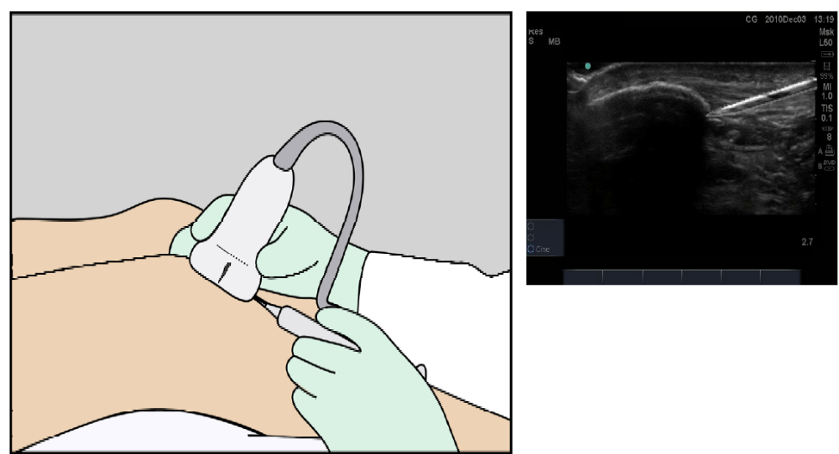
Tenex on Patellar tendon

Slide 17
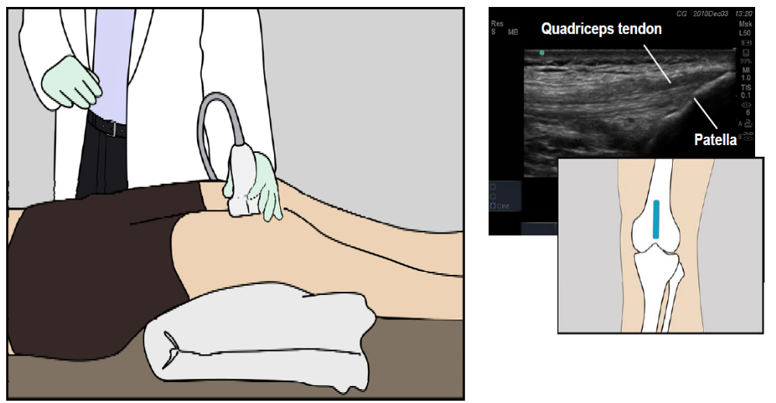
Patient and probe positioning Quad tendon

Slide 18
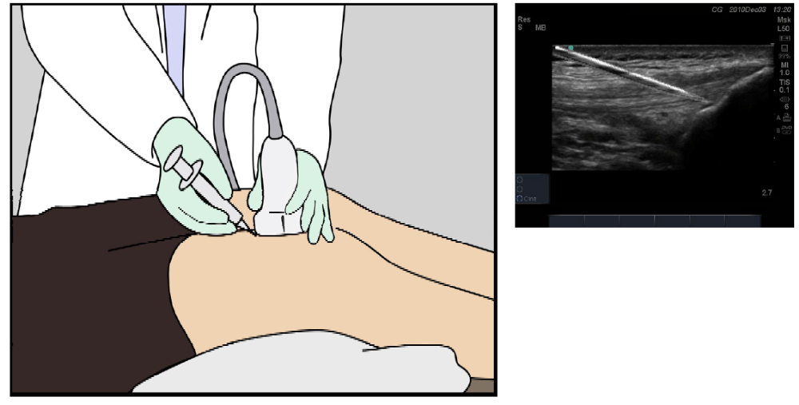
Tenex on Quad tendon

Slide 19
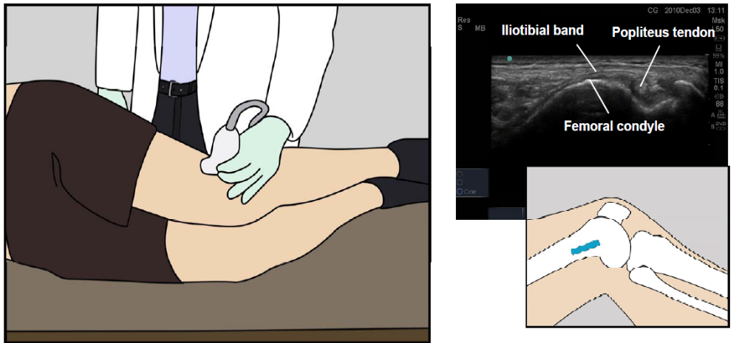
Patient and probe positioning IT band

Slide 20
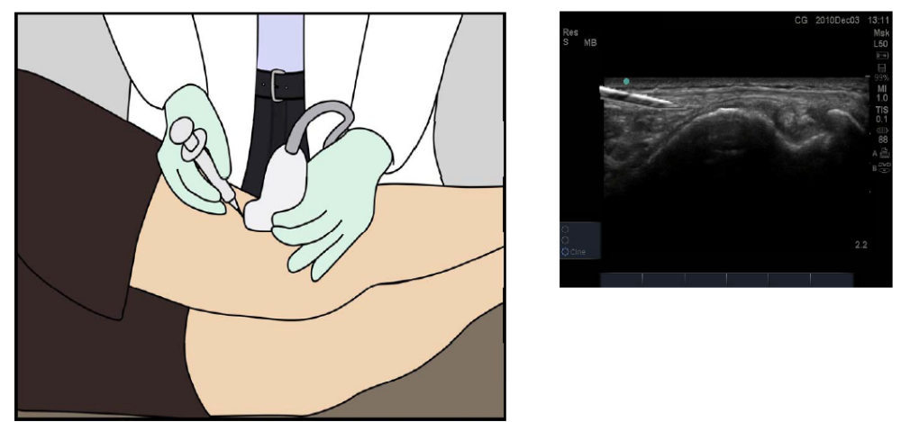
Tenex on IT band

Slide 21
Conclusion
Notify all users and facilities.
Opens the door for Hips, Shoulders, Glutes.
More referrals from PMR, Total Hips.
Popular Indications: RC calcifications, Partial Tear RC, Biceps Tendinosis, Greater trochanteric bursa, Glute insertion, Hamstring tear.
TX 2 Product number 554-2003-001

